Slide 1
Design, Develop, Implement & Document Community Portal Website
Module Project
Module: Web Development Foundations
Course: NICF Advanced Certificate in Software & Applications (Development & Deployment)
Start Date :
End Date : 9 March 2023
Submission Date :
Learner Name : Syukur Sidiq Nur Alam
Enrollment ID :
Presentation Date :

Slide 2
Contents
Document History
Version Number | Effective Date of release | Summary of Included Changes | Author
1 | 4th March 2016 | First Edition | Satya CVS
2 | 08th Sep 2017 | Changed for Module 5 | Shrinivas K R
3 | 20th Jul 2018 | Changed for Module 5 RQF | Shrinivas K R

Slide 3
Contents
Contents
S. No. | Description
01 | Development Tools
02 | Business Process
03 | Application Block Diagram
04 | Applications
05 | Models, Controllers & Classes Developed
06 | UI Design
07 | Includes
08 | Software Development Methodology
09 | Project Plan
10 | Application Screen Shots
11 | Project Milestones & Tasks
12 | Milestone Feedback & Action Taken
13 | Modifications Made On Feedback
14 | Project Results
15 | Proposed Improvements

Slide 4
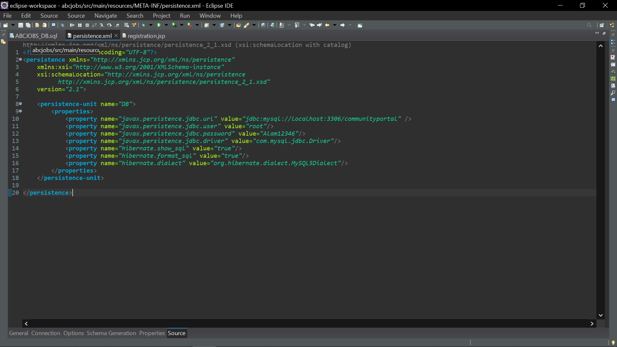

1. Development Tools
Development Tools Screen captures
Eclipse with JEE plugin for development
Server : Apache Tomcat 9

Slide 5
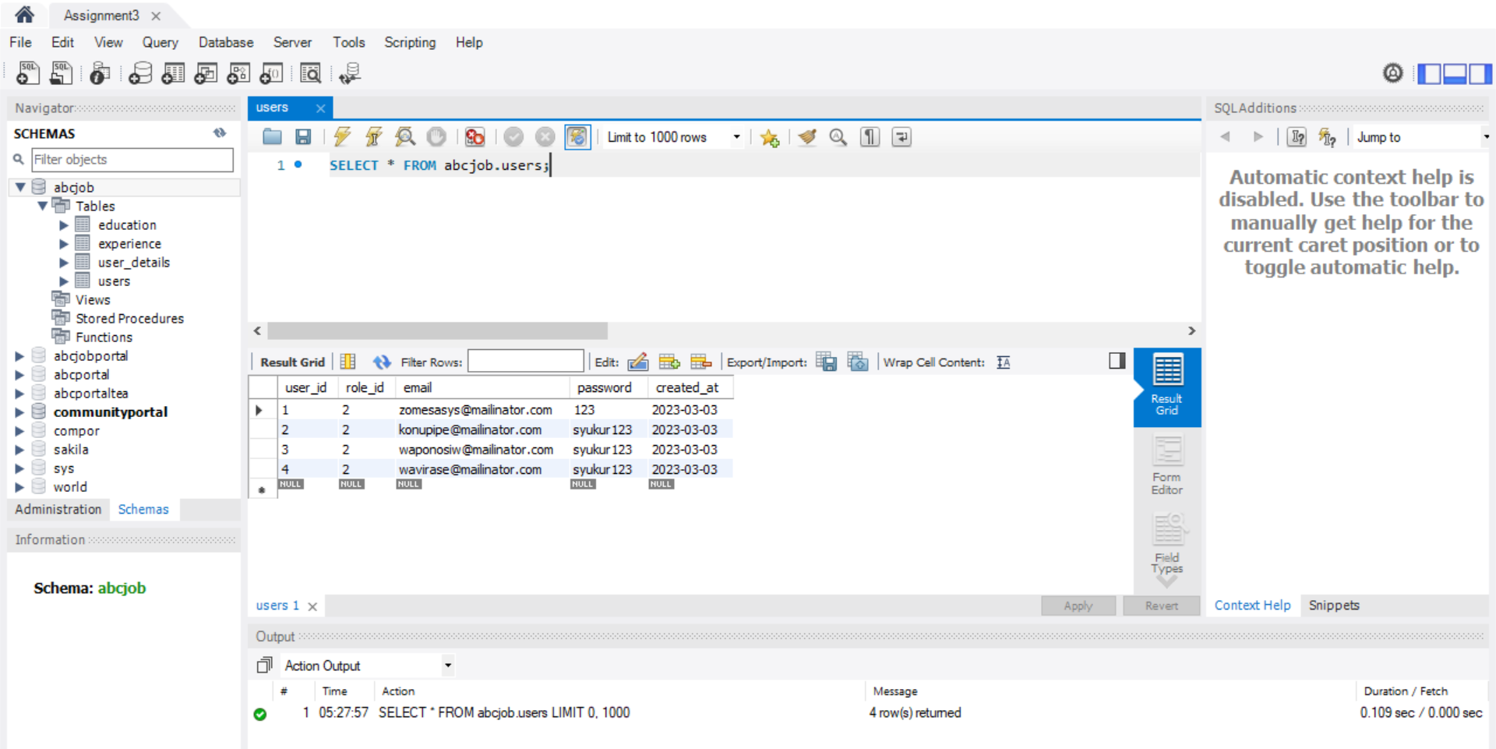
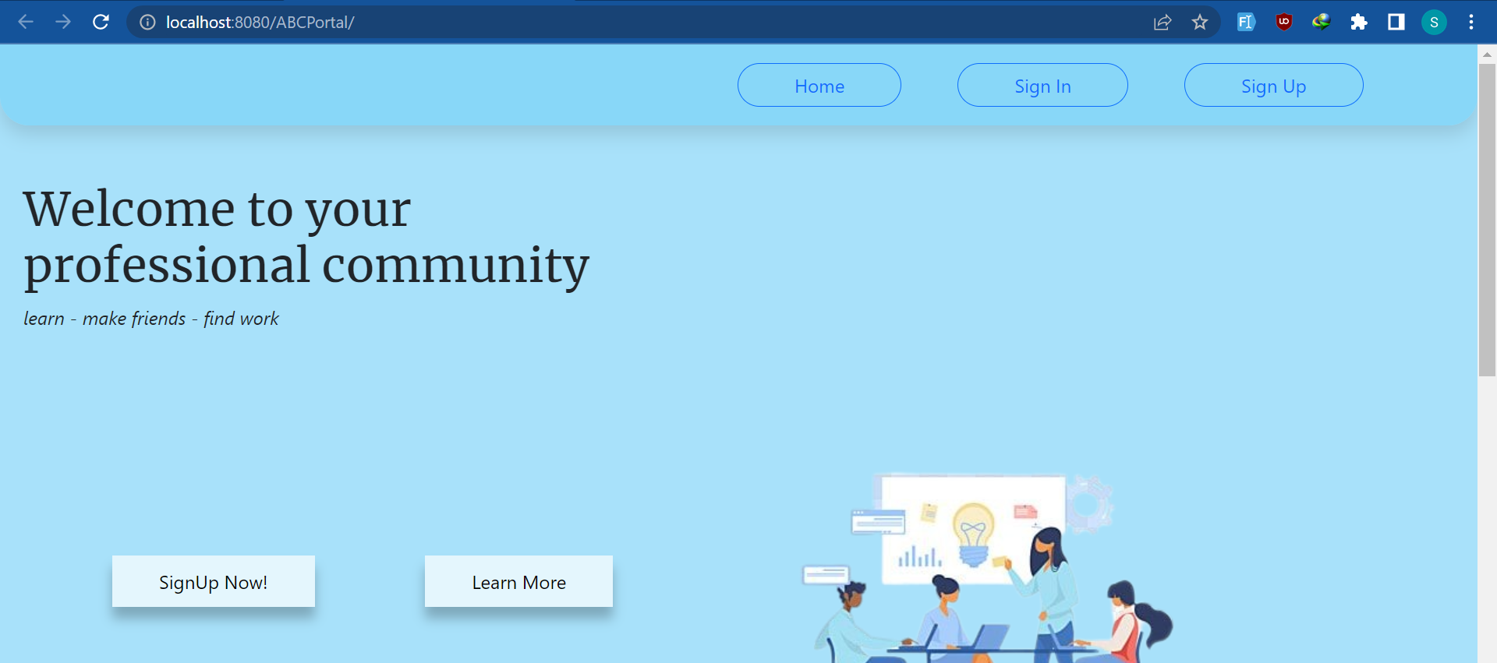
1. Development Tools
Development Tools Screen captures
Database : MYSQL Workbench
Browser : Chrome

Slide 6
2. Business Process
Block Diagram of Various Business Process
Use case diagram, flow chart of the modules etc
Activity Diagram
1. Registration
2. Login
3. Update Profile
4. Retieve Password
5. Search

Slide 7
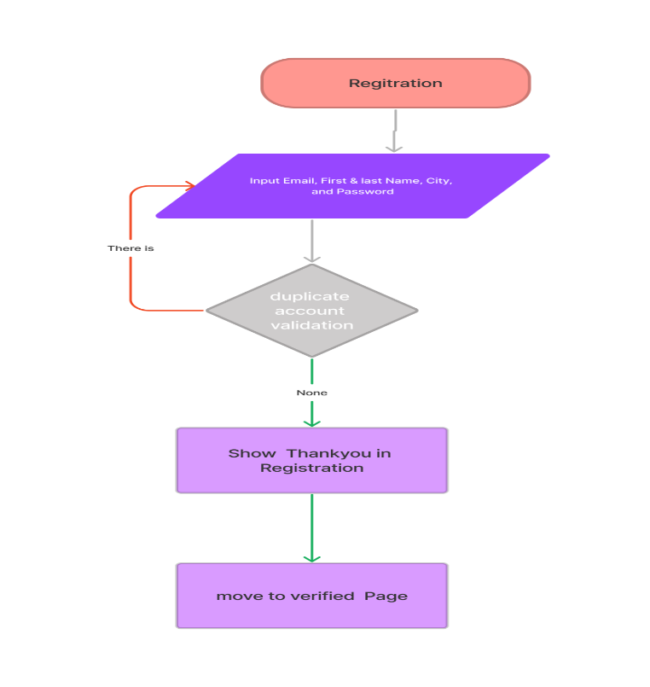
2. Business Process
Activity Diagram (Scenario flow
Registration

Slide 8
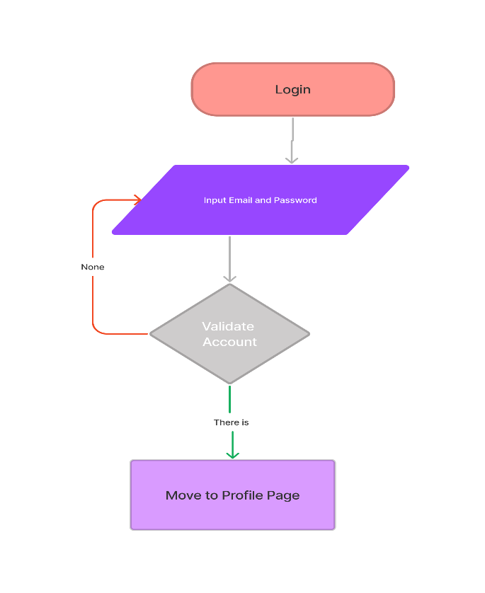
2. Business Process
Activity Diagram (Scenario flow
Login

Slide 9
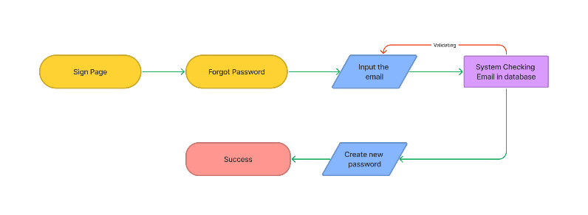
2. Business Process
Activity Diagram (Scenario flow
Forgot Password

Slide 10
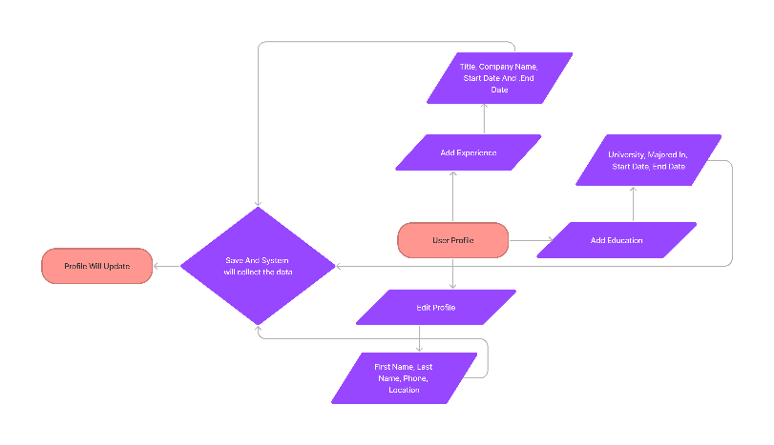
2. Business Process
Activity Diagram (Scenario flow
Update Profile

Slide 11
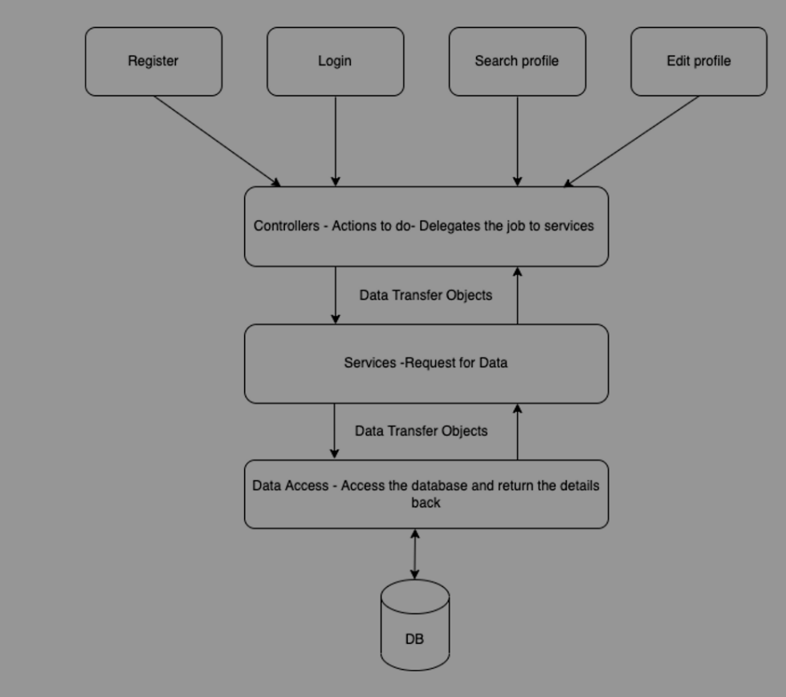
3. Application Block Diagram
Explanation :
Firstly every request that come from the user will be handled by the front controller which is a servlet called DispatcherServlet, it Is used to handle the request and dispatched the request to particular controller. The controller will give response depends on what the request is, if the request need data from database controller need to connect to service, so the service can communicate to the database and send response back to the controller.

Slide 12
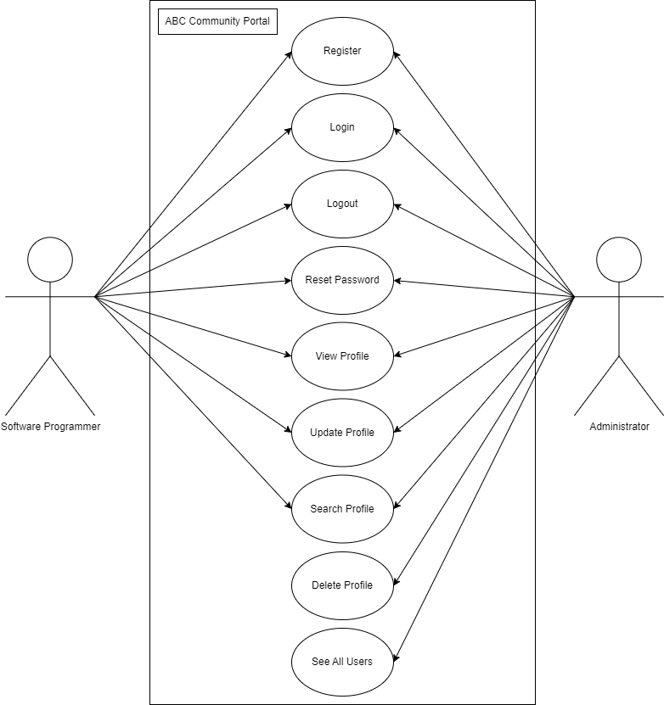
3. Application Block Diagram
Block Diagram of the Over all Application
Use Case Diagram

Slide 13
3. Application Block Diagram
Block Diagram of the Over all Application
EXAMPLE - Login Process

Slide 14
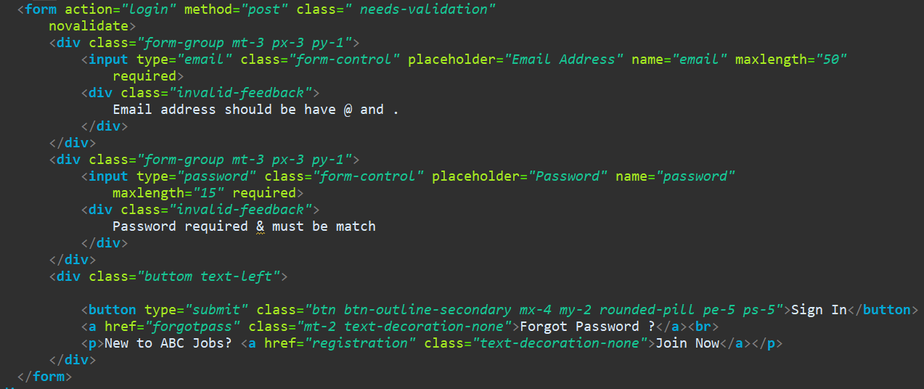

3. Application Block Diagram
Block Diagram of the Over all Application
Process | Description
 | This login form consist of two field with the required attributes, so the users can’t leave the input blank, once the users submit the form, it is submitted using the HTTP POST method and send parameters to the Login action
 | The @RequestMapping annotation in the controller code tells Spring MVC to handle HTTP POST requests to the "/login" URL. and also, this method is using Users object as model attribute to bind the parameter that is passing by the user, so now it is possible for the controller to use the Users model to pass the value over the service
 | After that, the Users model which has been passess through from the input will be checked if it exist or not using custom method from the service.

Slide 15
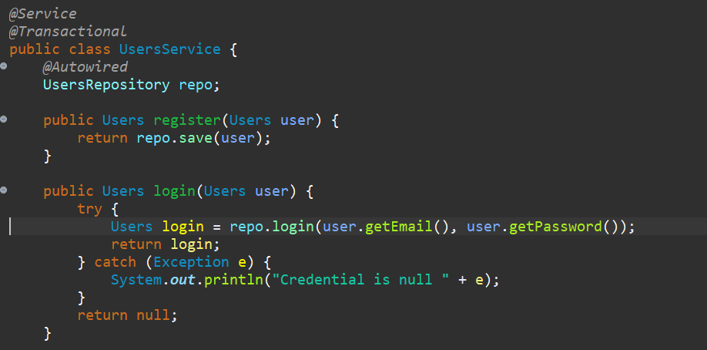
3. Application Block Diagram
Block Diagram of the Over all Application
 | Description
 | In the service class, it is defined as @Service and @Transactional annotation cause in this service class it will performs business logic and manipulates data from the repository. Actually there are many default methods provided by the repository, but because In this login process I need to find the details of the users according to their email and password, so that I create a custom methods manually and use the specific queries in the repository. In this method I’m passing two parameters to the repository which is users_Email, and users_Password, I put the statement inside a try catch block, so that If there is any exception it will return null back to the controller
 | I am using a custom method, so it will fetch methods which are not derived from the default methods provided by CrudRepository, and I define all the custom query as a @query annotations. This query will select a specific user from the database according to the email and password fields, so this query method requires two parameters to execute

Slide 16
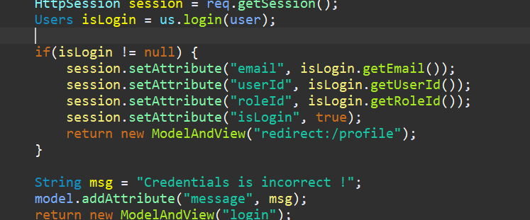
3. Application Block Diagram
Block Diagram of the Over all Application
 | Description
 | Once the service find the mathed users in the database so now it possible to use other fields in the model such as user_id, email, in order to set the session, and Finnally users able to access the dashboard.
 | I am using a custom method, so it will fetch methods which are not derived from the default methods provided by CrudRepository, and I define all the custom query as a @query annotations. This query will select a specific user from the database according to the email and password fields, so this query method requires two parameters to execute

Slide 17
4. Applications
Description of Applications being Developed:-
Private module
All User
Bulk Email
Public module
Registration
Login
Forgot Password
Search and result
Viewing other profiles

Slide 18
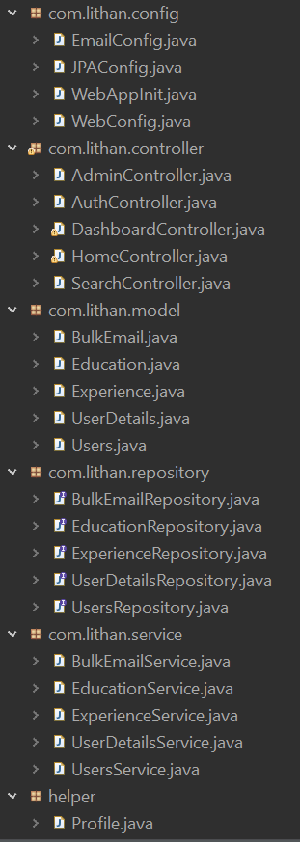
5. Models, Controllers, Classes Developed
Overview of Models, Controllers & Any Classes Developed
Controllers & Any Classes Developed

Slide 19
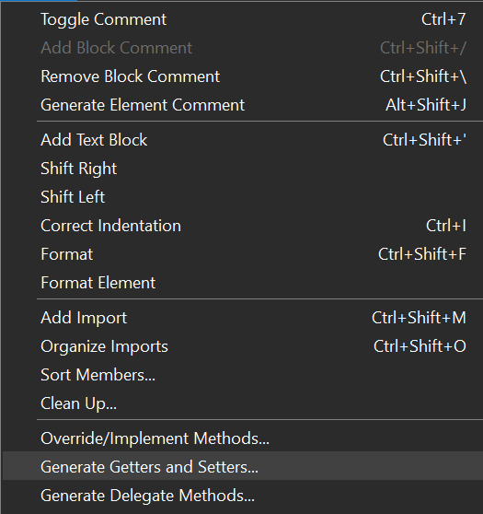
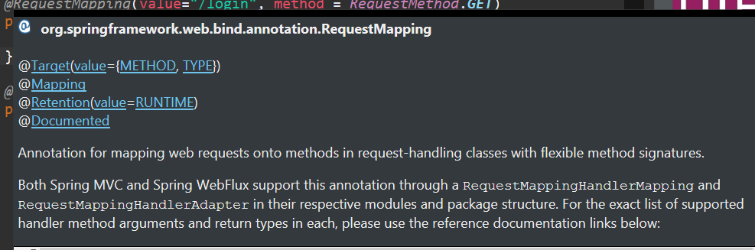
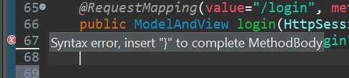
6. Tool Screens- Eclipse
Tool Screens
1. Has automatic Source Generator
2. Give Us Information when we point the cursor into a code that we dont understand
3. Can Fix Errors by suggestion

Slide 20
7. Classes - Entities
Entities
S. No. | Class Name | Description
1 | User.java | Used to store user account credentials, including email and passworod information
2 | UserDetails.java | stores user data such as name, phone number, and place of residence
3 | Education.java | Save Education detail data
4 | Experience.java | Save experience detail data
5 | BulkEmail.java | Send information to all users

Slide 21
8. Classes Developed
Business Classes
S. No. | Class Name | Description
1 | AdminController | This controller will handle every request that came from Administrator
2 | AuthController | This controller will handle every credential request such as registration, login, forgot password.
3 | DashboardController | This controller will handle every request accessing the dashboard
4 | HomeController | This controller will handle every request accessing the home, thankyou and verified
5 | SearchController | This controller will handle every request for searching other users and see their profile
6 | BulkEmailService | This service will connect Controller to BulkEmailRepository
7 | EducationService | This service will connect Controller to EducationRepository
8 | ExperienceService | This service will connect Controller to ExperienceRepository
9 | UserDetailsService | This service will connect Controller to UserDetailsRepository

Slide 22
8. Classes Developed
Business Classes
S. No. | Class Name | Description
10 | UsersService | This service will connect Controller to UsersRepository
11 | BulkEmailRepository | This Repository will connect the program to bulk_emailtable
12 | EducationRepository | This Repository will connect the program to education table
13 | ExperienceRepository | This Repository will connect the program to Experience table
14 | UserDetailsRepository | This Repository will connect the program to users details table
15 | UsersRepository | This Repository will connect the program to users table

Slide 23
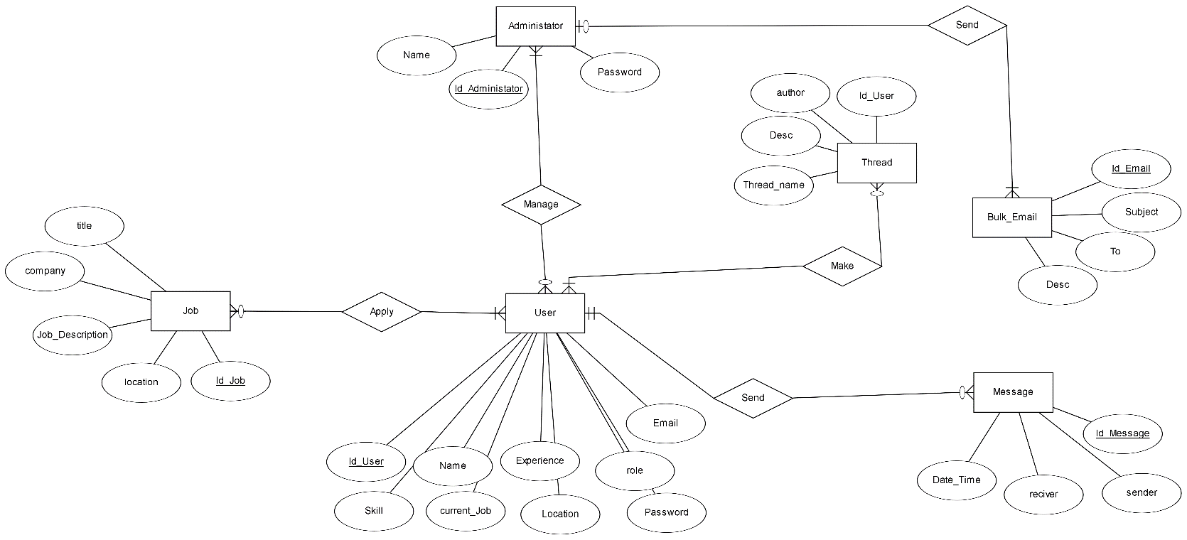
9. Database Design
ER Diagram

Slide 24
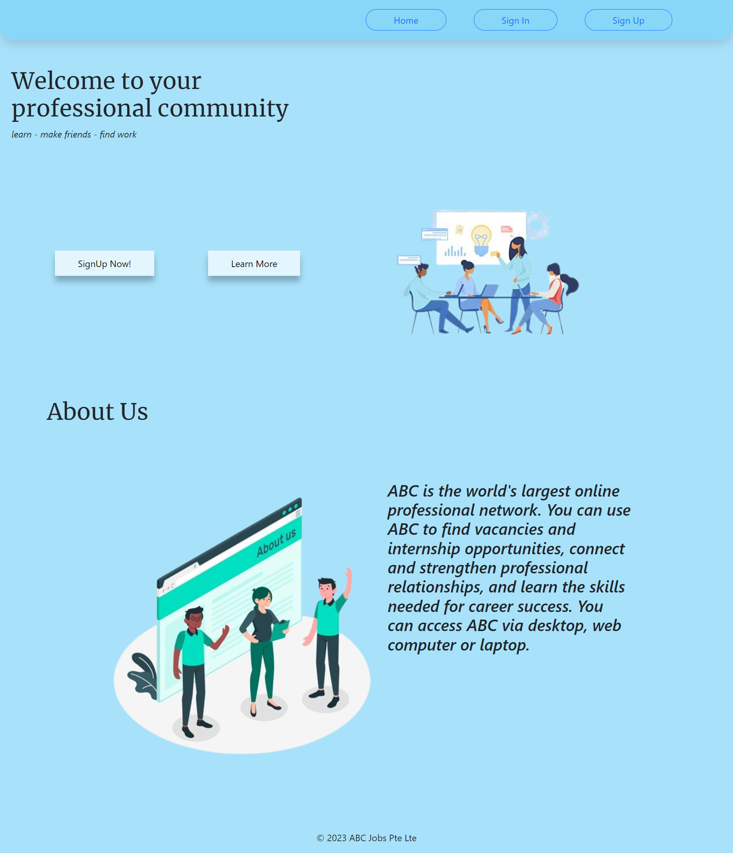
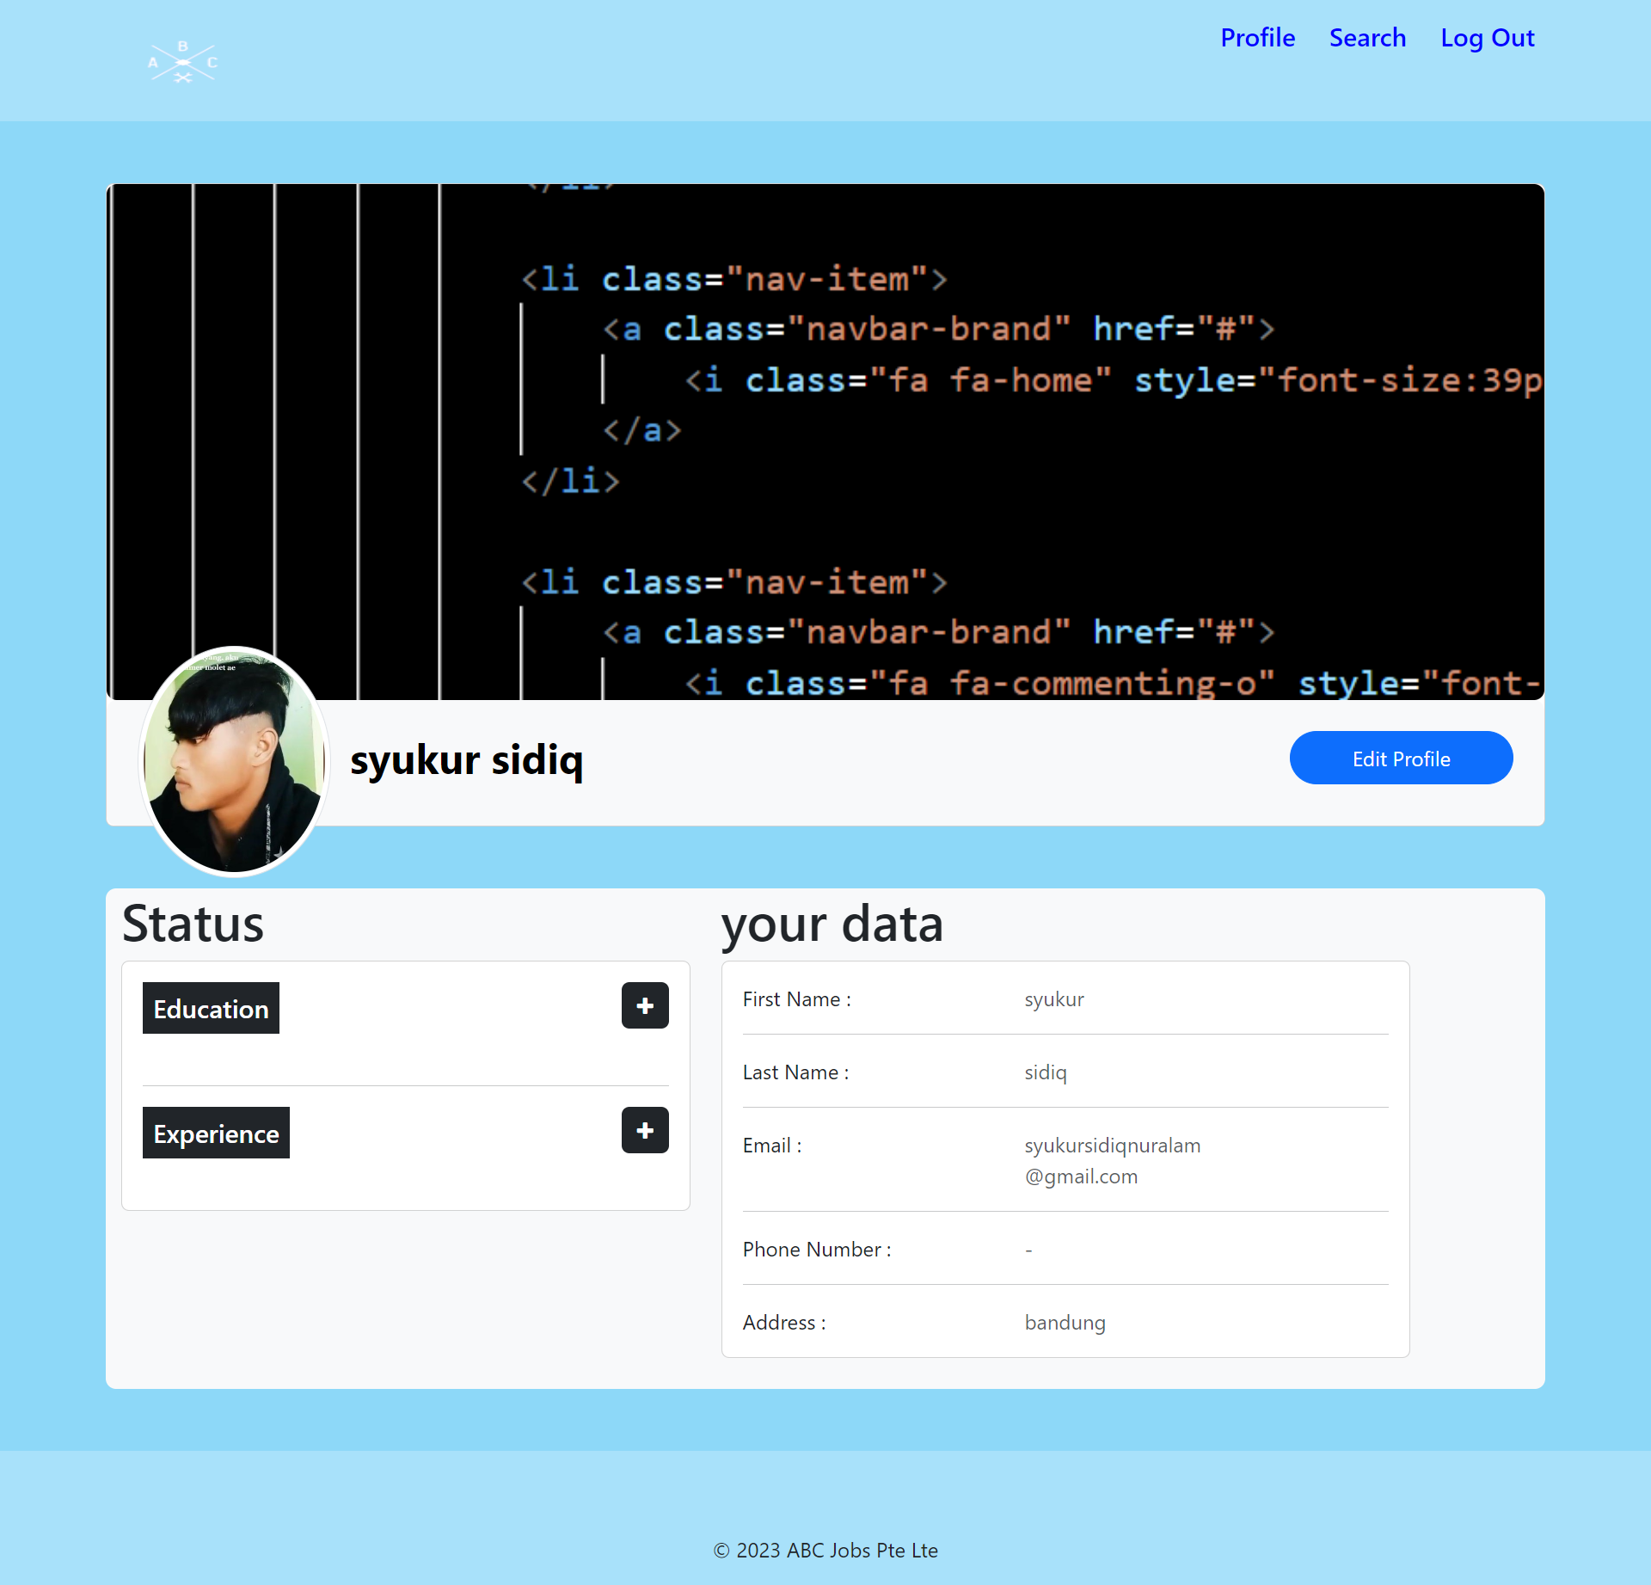
10. UI Design
UI Design
Dashboard Page
Home Page

Slide 25
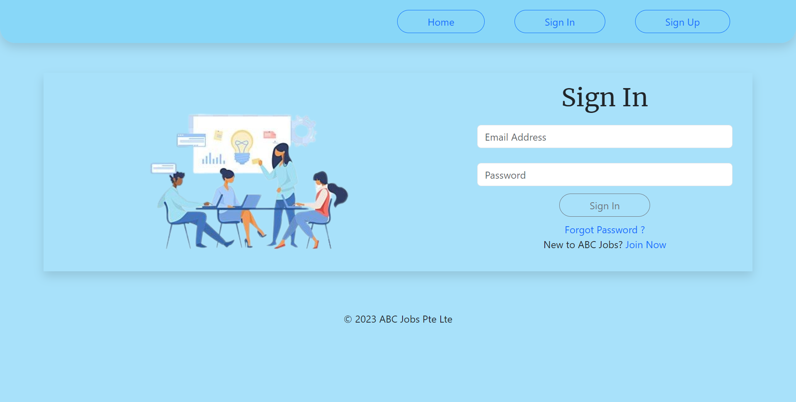
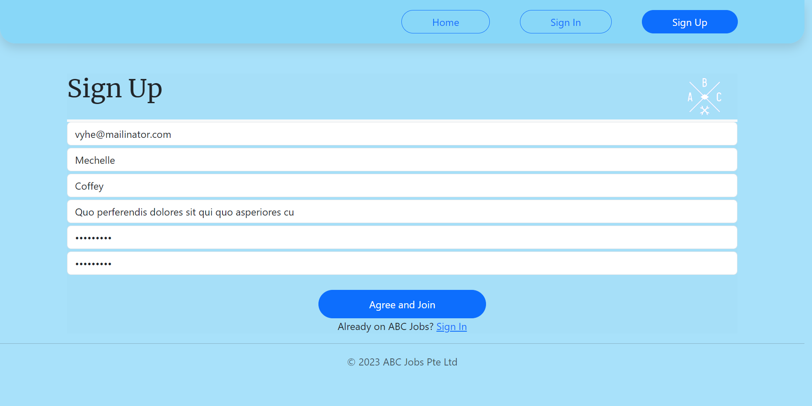
10. UI Design
UI Design
Sign In Page
Sign Up Page

Slide 26
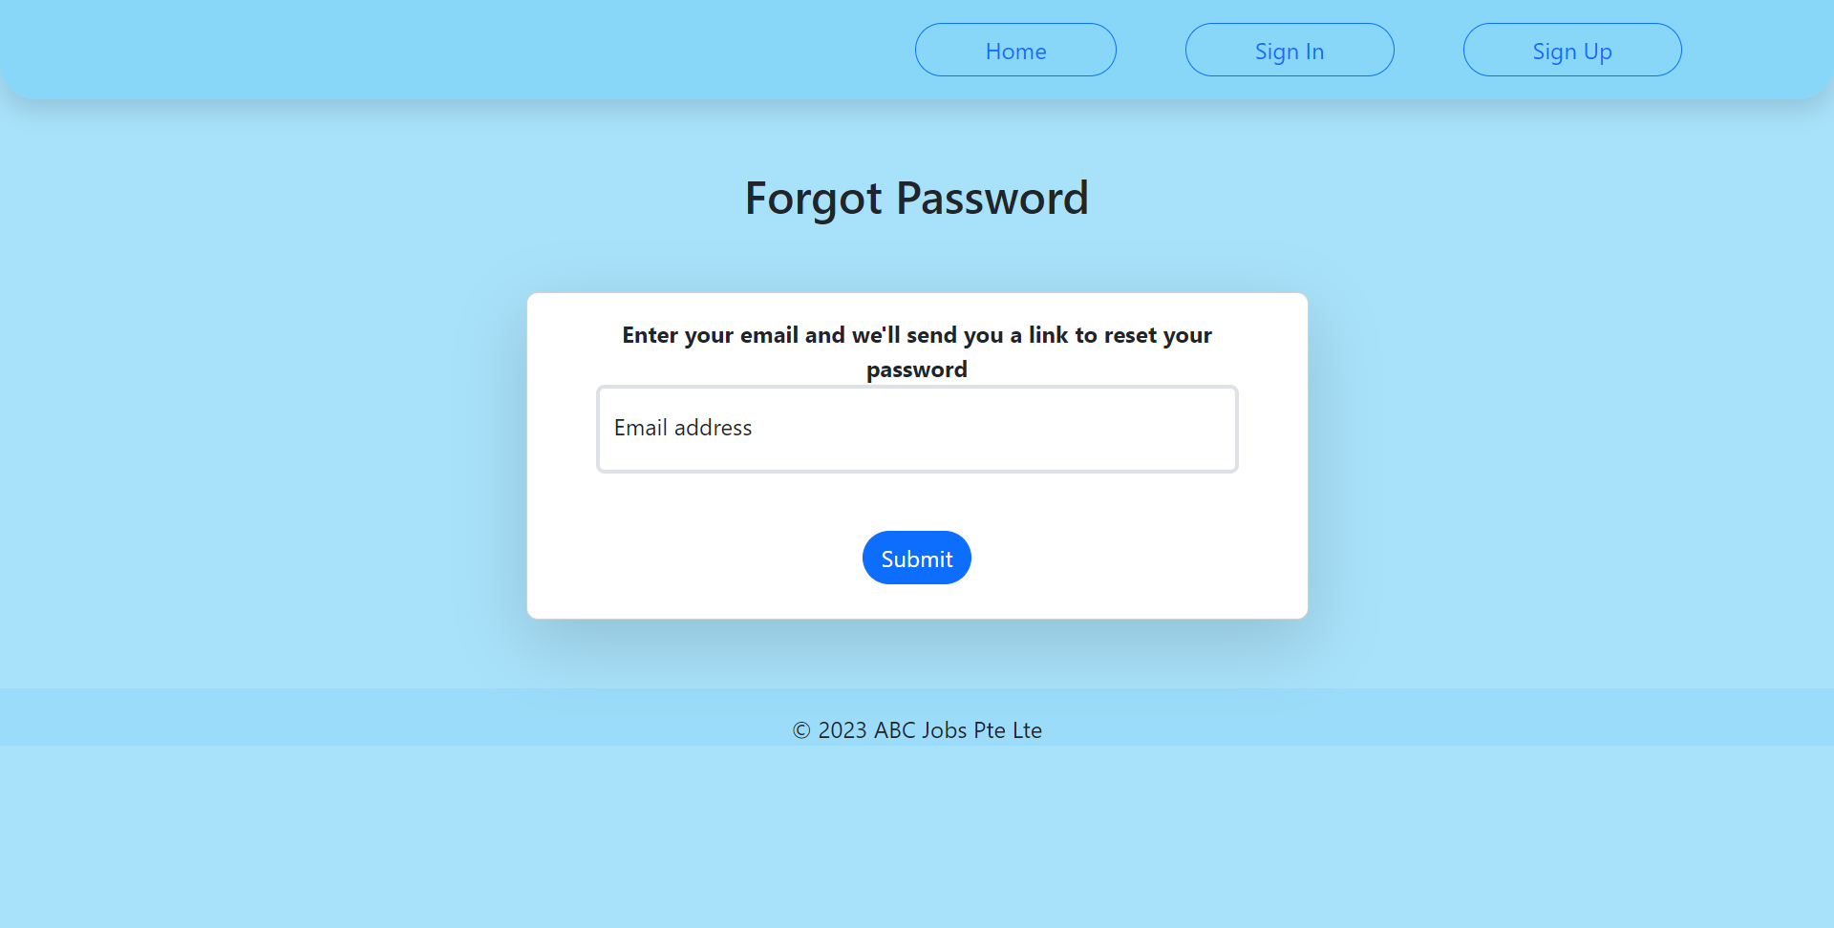
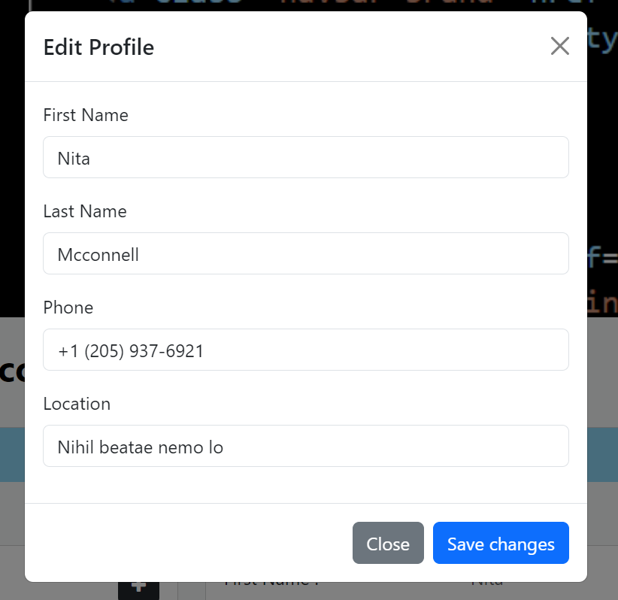
10. UI Design
UI Design
Forgot Password Page
Edit Profile

Slide 27
11. Spring Frameworks
Java Spring Includes
S. No. | Include | Purpose of Include
1 | Spring Core | This module offers numerous functionalities for developing JEE applications, including dependency injection and management beans.
2 | Spring data | Provide a collection of APIs that simplify working with various data storage, including relational databases and NoSQL databases.
3 | Spring MVC | This module is the implementation of Model View, and Controller

Slide 28
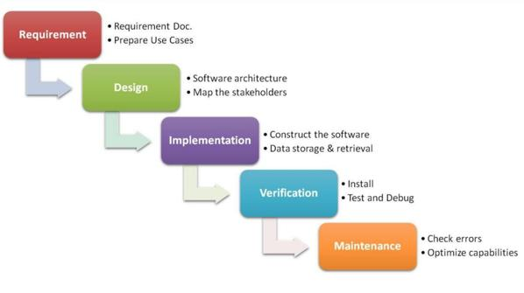
12. Software Development Methodology
Software Development Methodology being used
The project uses a waterfall model that follows a linear and sequential approach, meaning each phase must be completed before moving on to the next. By using this model, programmers can control the development process easily. The model consists of requirements gathering, design, implementation, testing, and maintenance, with each phase depending on the output of the previous phase.

Slide 29
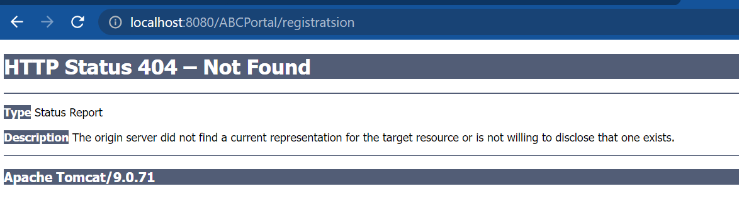
14. Application Screen Shots
This error occurs because the button that is selected or the url that you want to visit does not exist, this error often occurs due to author error when entering the url.

Slide 30
15. Project Milestones & Tasks
Project Task ID | Project Task Description | Project Milestone ID
1 | Setup the Development Environment based on the Technical Development Environment | 1
2 | Power point Detailing the Business Process in the Proposed Application | 1
3 | Project Report detailing the Technical Design | 1
4 | Power Point Detailing the Project Plan | 1
5 | Develop the UI HTML standard pages (Based on Module 3 work) | 2
6 | Create common Spring Includes, Models, Views & Controllers | 2
7 | Develop Classes | 2
8 | Develop Spring Application | 2

Slide 31
16. Project Milestones & Tasks
Project Task ID | Project Task Description | Project Milestone ID
9 | Develop Test Cases | 3
10 | Develop Project Documentation | 3
11 | Develop User Manual | 3

Slide 32
17. Milestone Feedback & Action taken
Project Milestone ID | Milestone Feedback received from Tutor / Learning Facilitator | Action Taken (Yes / No)
1 | Problem faced during | Yes
2
3

Slide 33
18. Modifications Made based On Feedback

Slide 34
19. Project Results
List of Pages
Landding Page

Slide 35
19. Project Results
List of Pages
Login Page

Slide 36
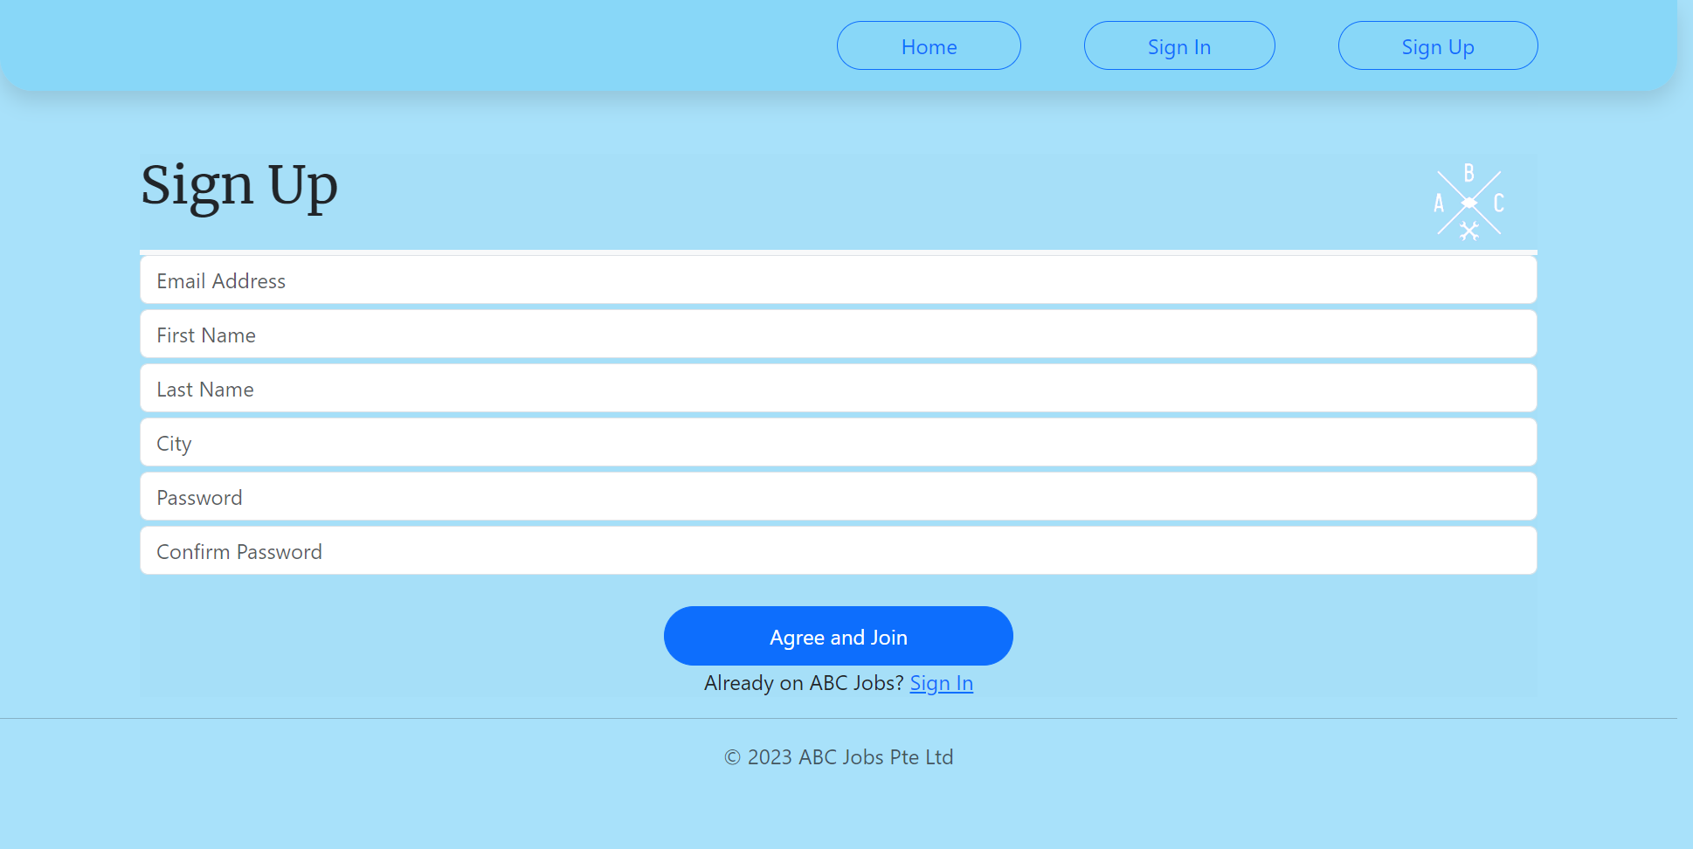
19. Project Results
List of Pages
Registration Page

Slide 37
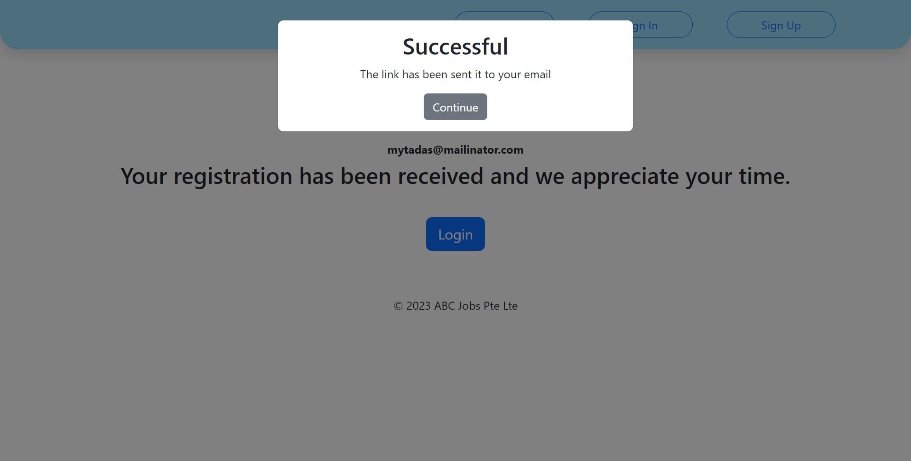
19. Project Results
List of Pages
Registration Page

Slide 38
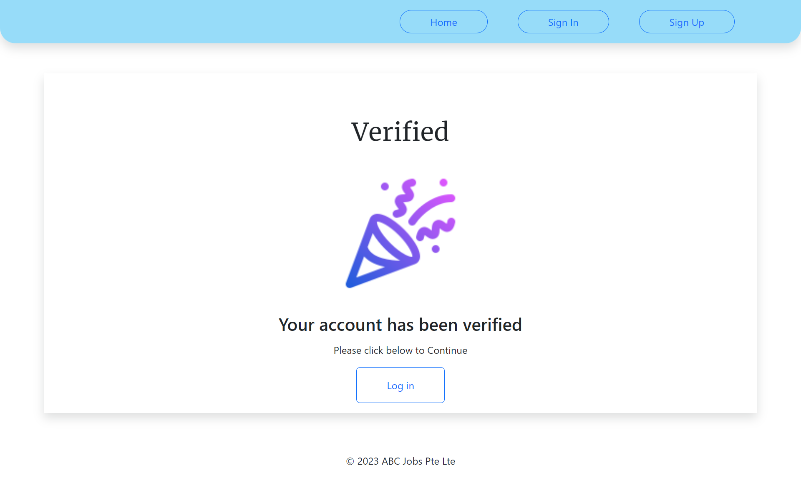
19. Project Results
List of Pages
Verify Page

Slide 39
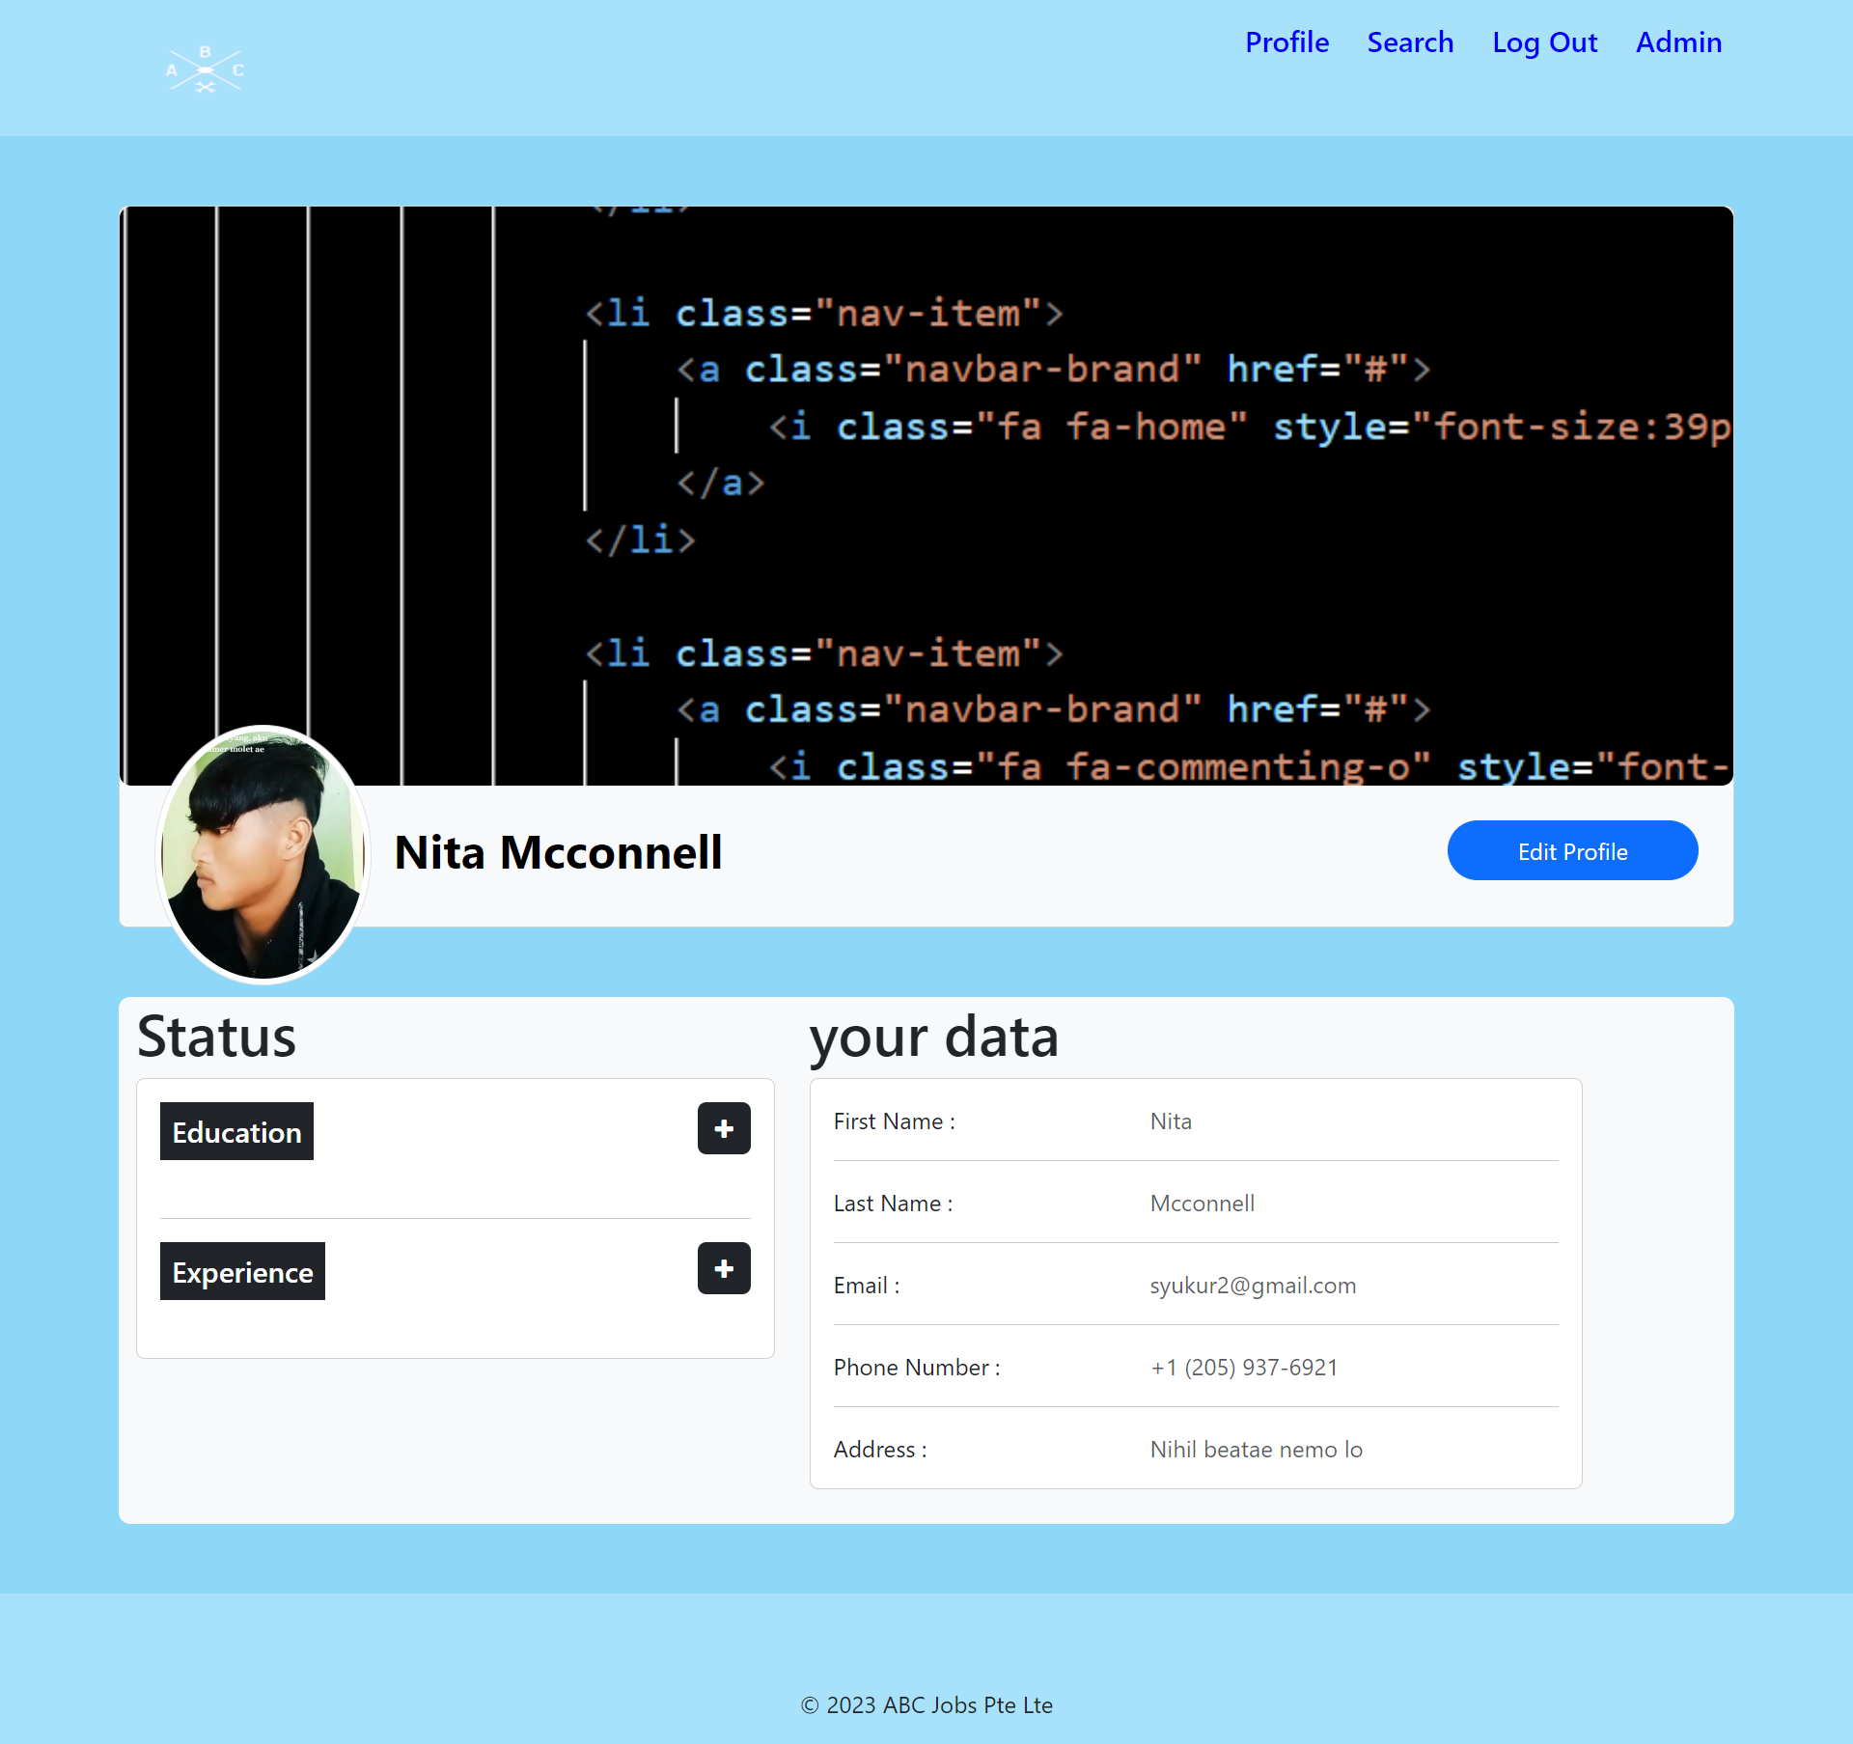
19. Project Results
List of Pages
Profile Page

Slide 40
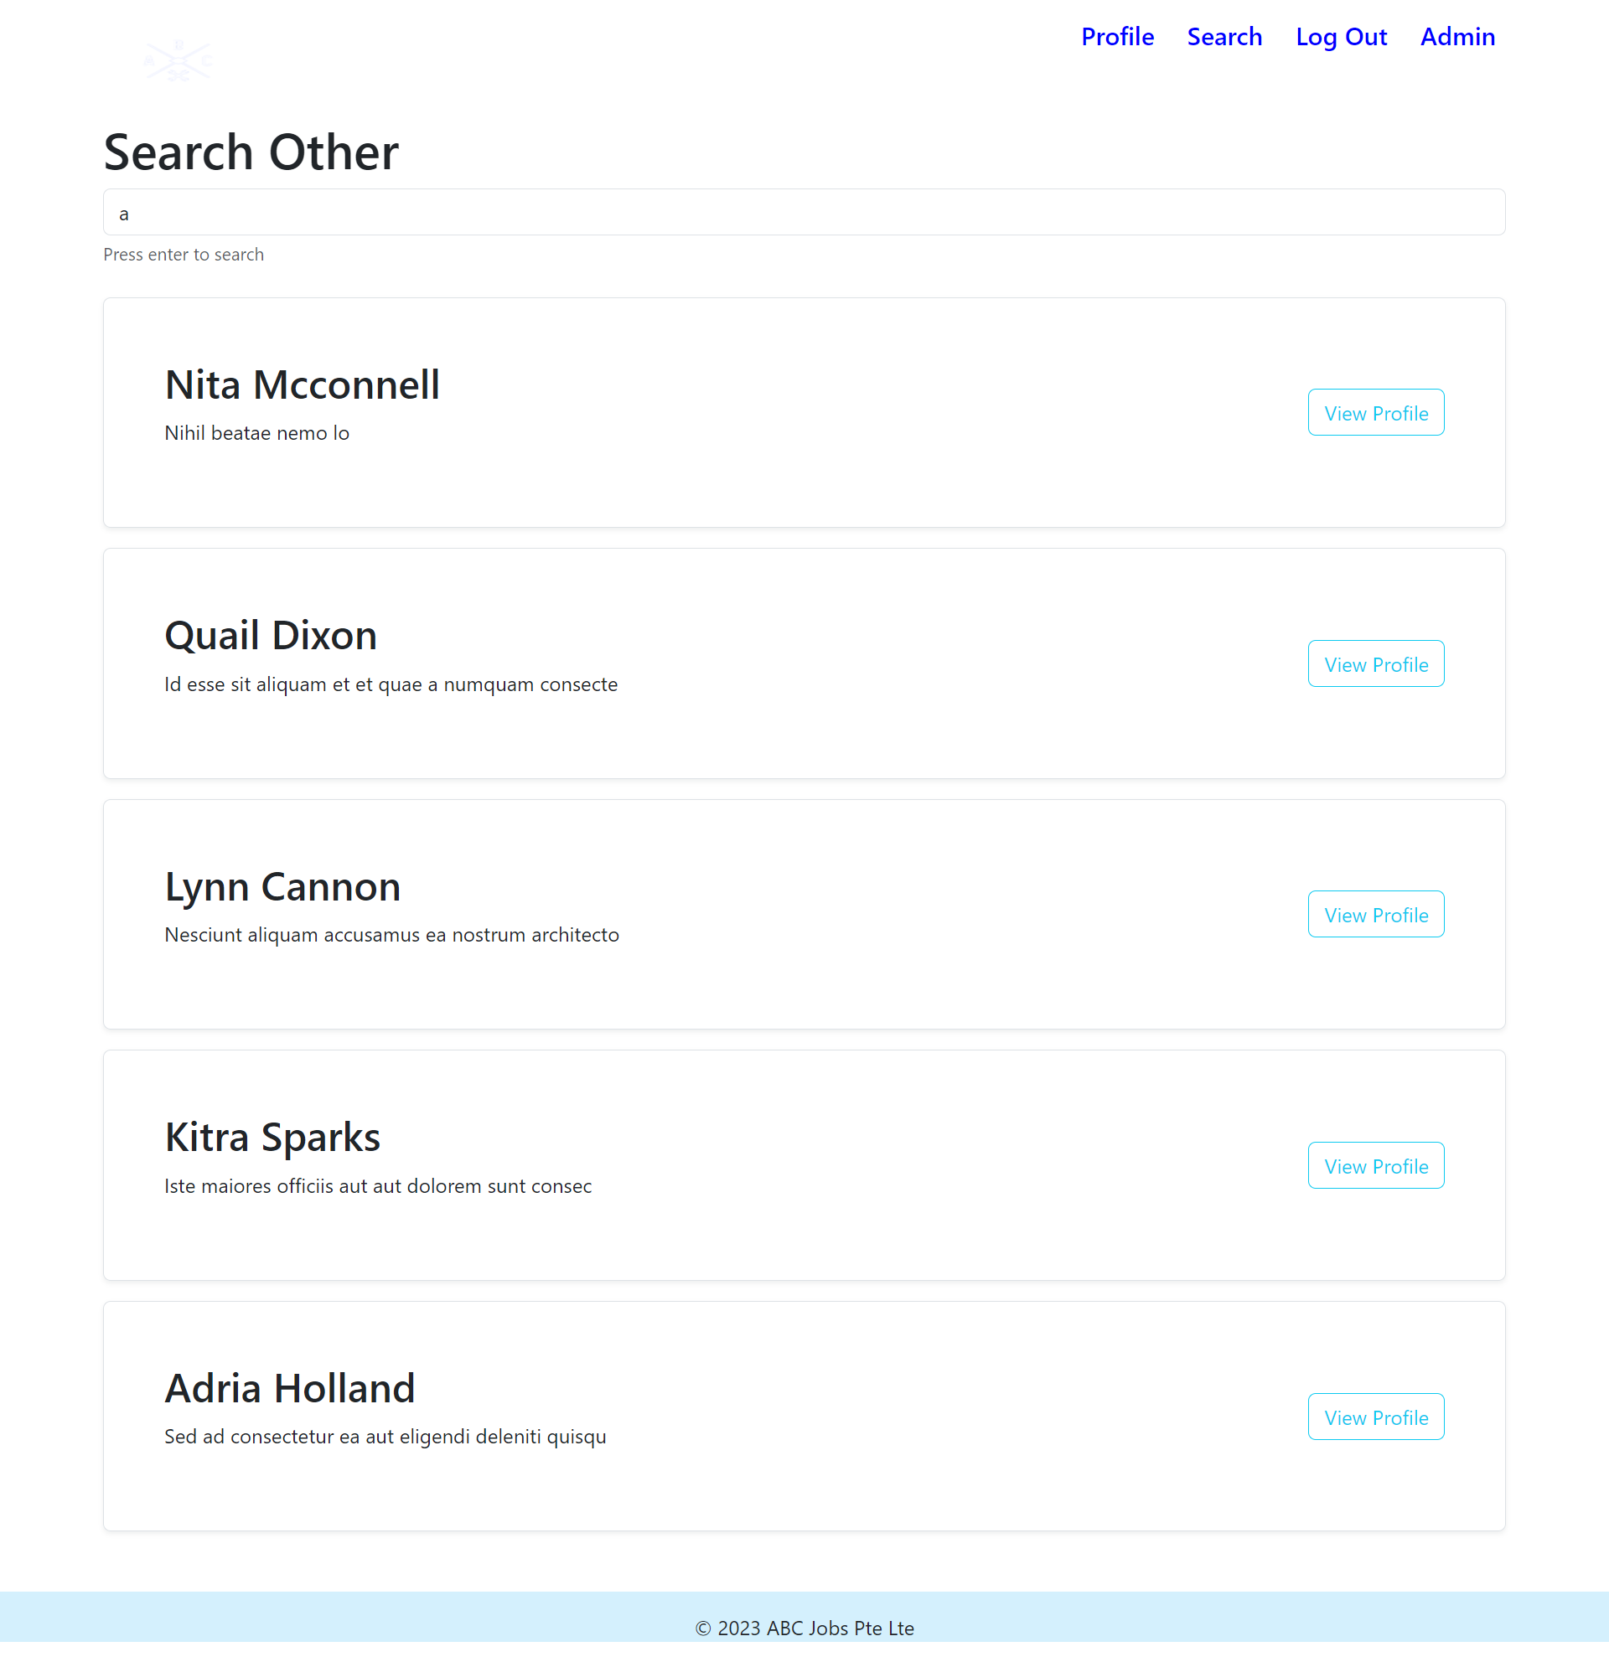
19. Project Results
List of Pages
Search Page

Slide 41
19. Project Results
List of Pages
Landding Page

Slide 42
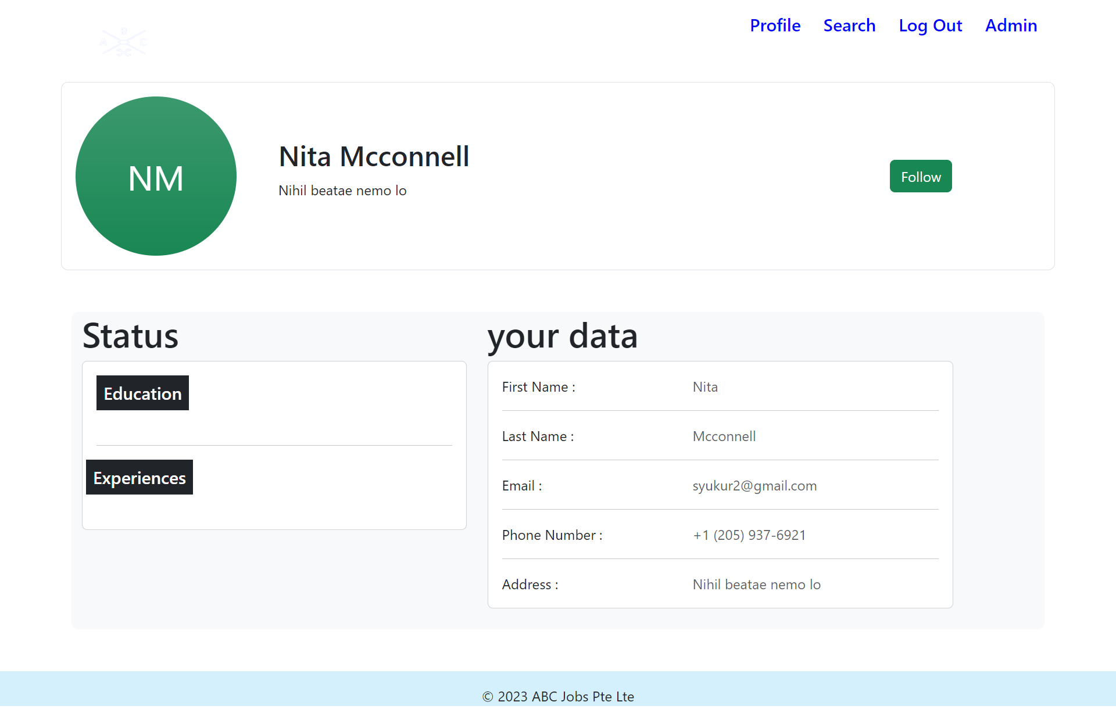
19. Project Results
List of Pages
Result Page

Slide 43
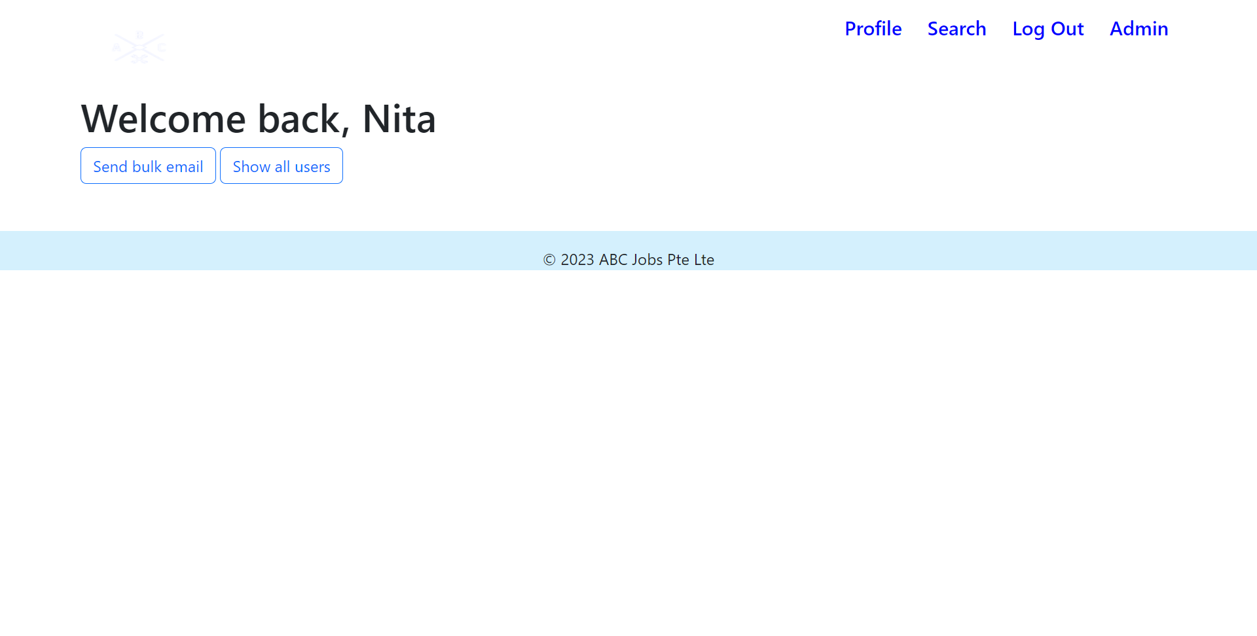
19. Project Results
List of Pages
IndexAdmin Page

Slide 44
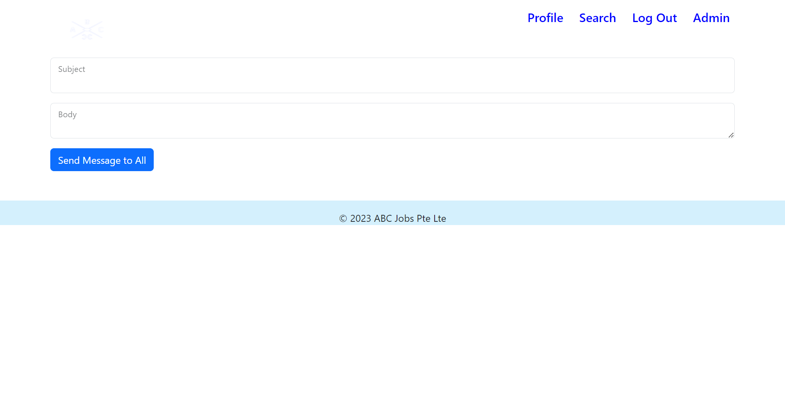
19. Project Results
List of Pages
Bulk-Email Page

Slide 45
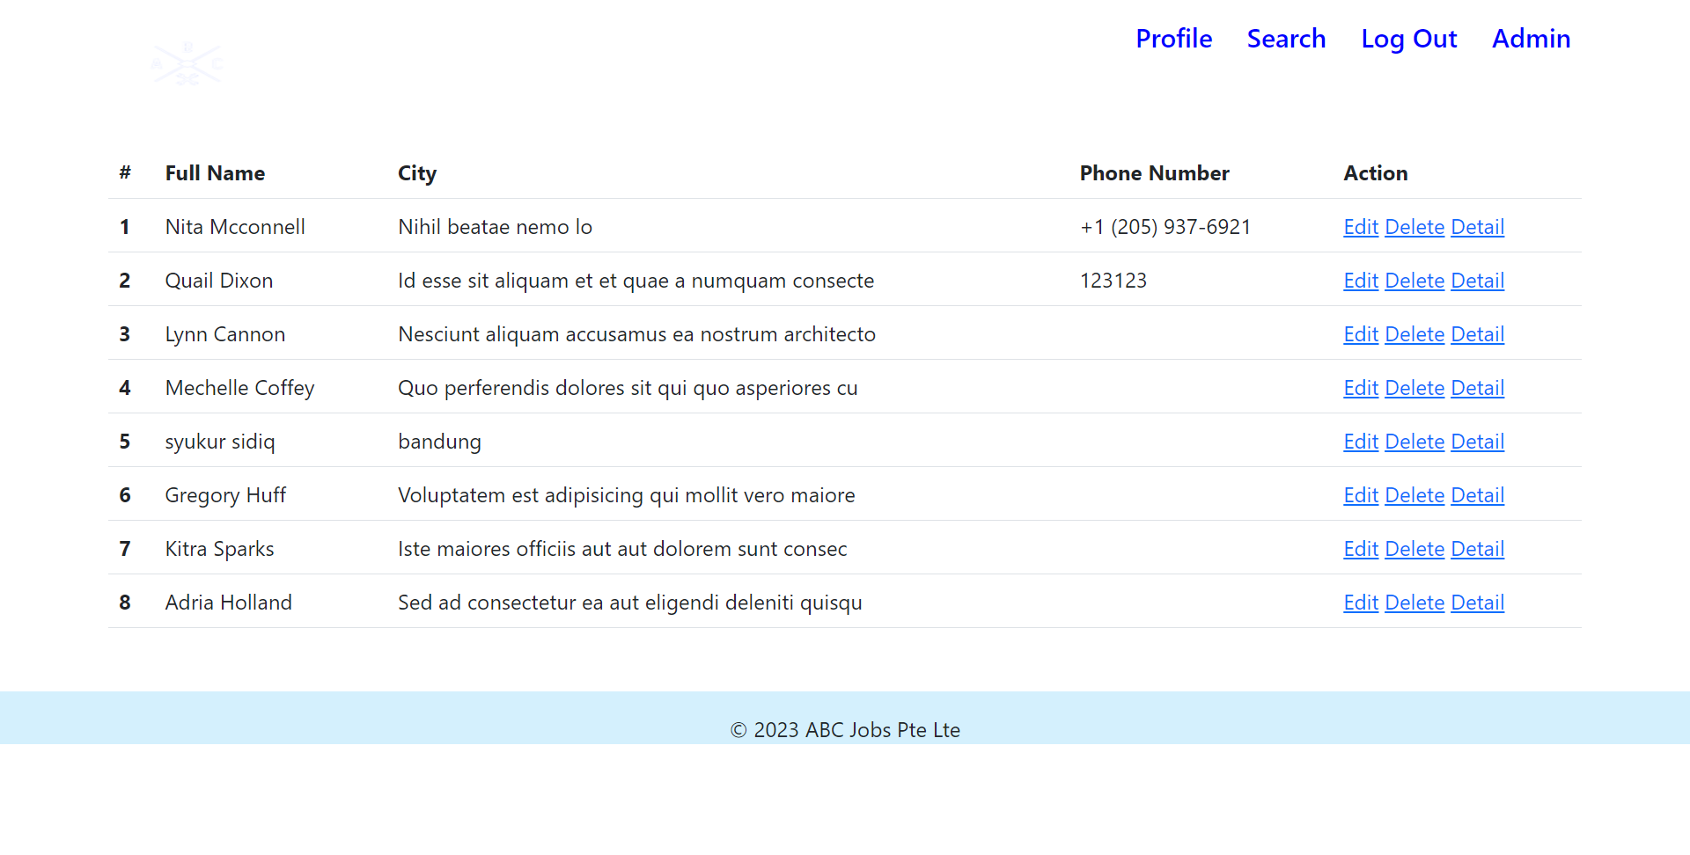
19. Project Results
List of Pages
All-users Page

Slide 46
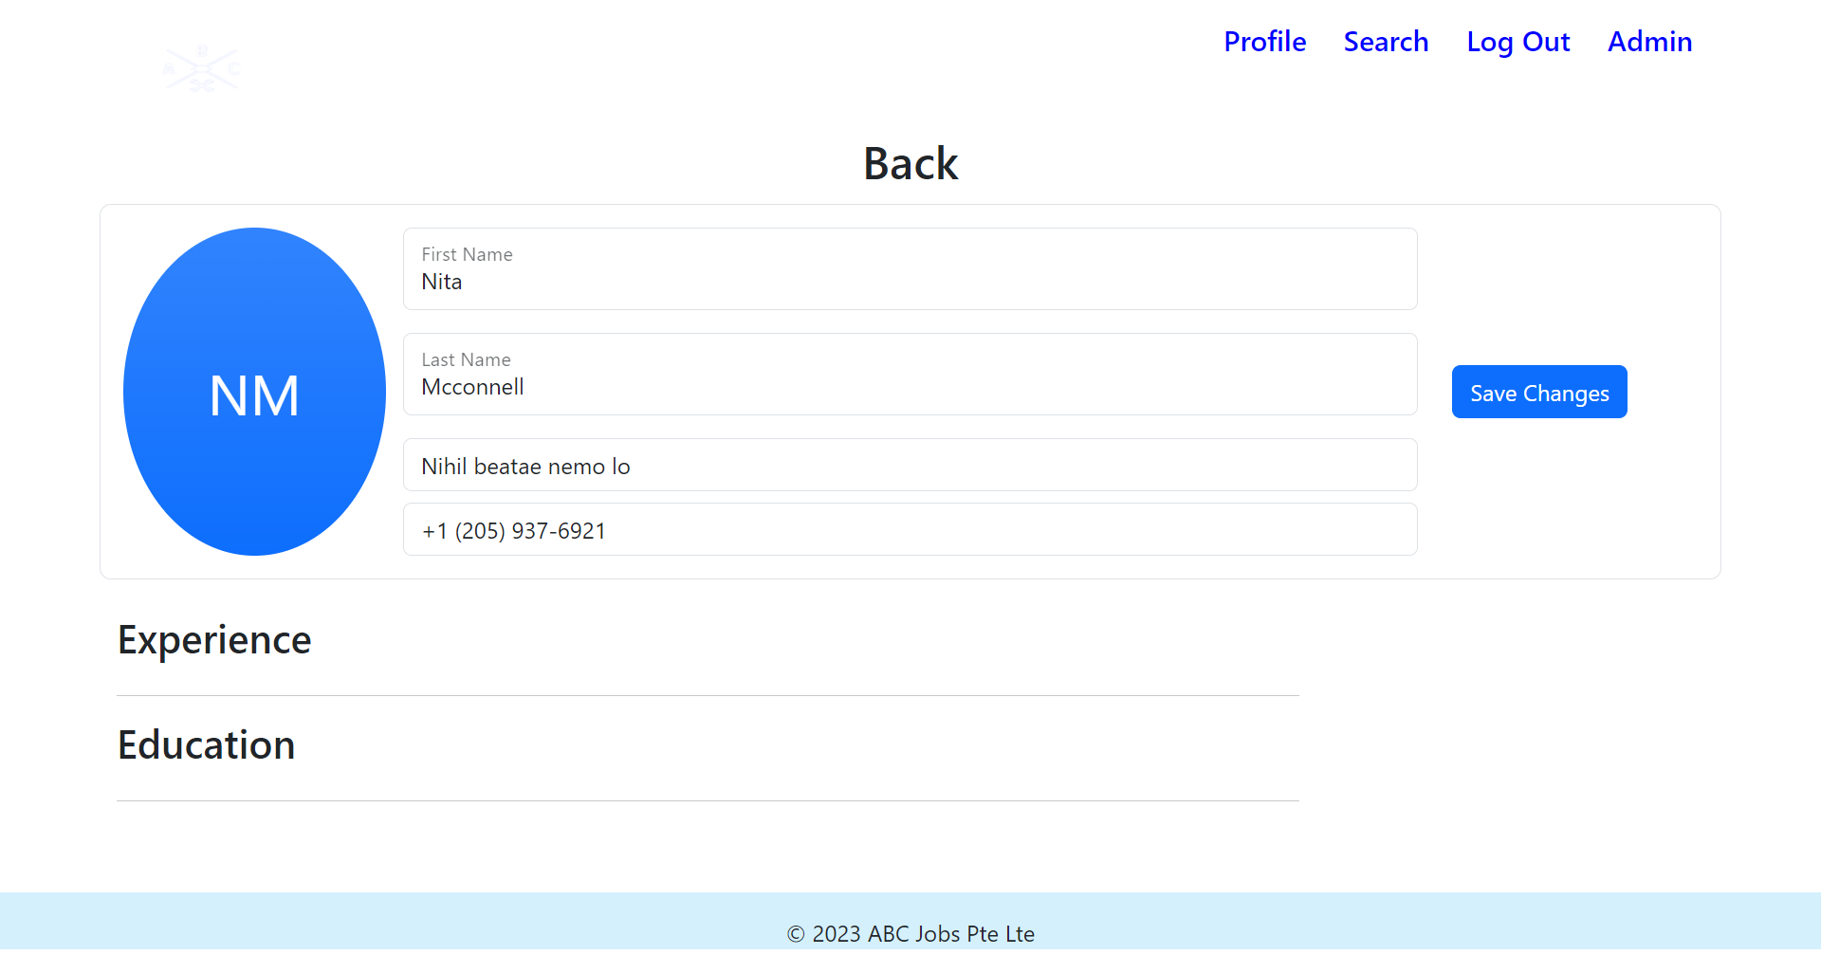
19. Project Results
List of Pages
Updatepeople Page

Slide 47
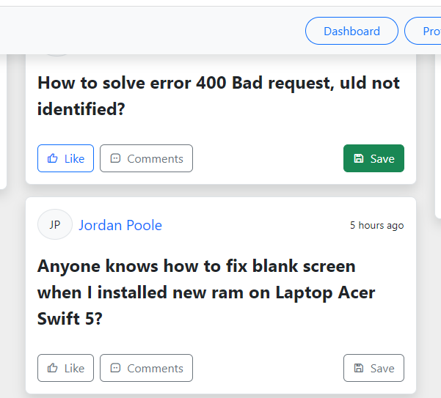
20. Proposed Improvements
List of Improvements
Button to like, comment and save

Slide 48
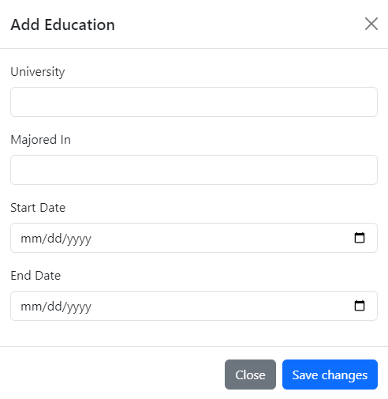
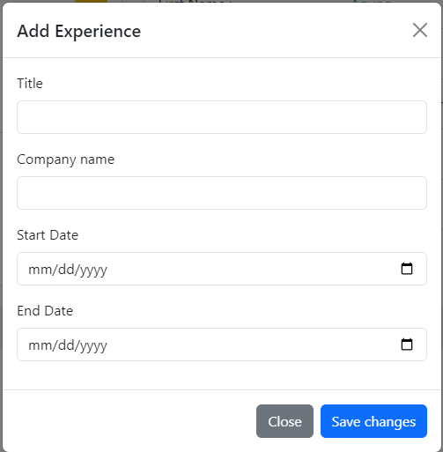
20. Proposed Improvements
List of Improvements
Add more detail about education.
Add more detail about experience

